Slide 1
Underwater Wireless
Communication
Presented By
Nikhilesh Shinde
Shyam Kumar Sahu
PCCOE

Slide 2
Summary
Background &Introduction
UW Architectures and UWSN
Applications
Research challenges
Advantages and Disadvantages
Future Expansions
Notes:
Only general

Slide 3
Background
In Early 1990 underwater communication
systems involve SONAR Technology
for Submarine & Obstacle detection.
Underwater wired media for oil & Gas
stations Monitoring.

Slide 4
Why Underwater Wireless networks ?
Wired media does not provides guaranteed
transmission of information.
Much slower speed of acoustic propagation
in water, about 1500 m/s.
Conventional Sound Waves does not work
well in an Shallow underwater environment.

Slide 5
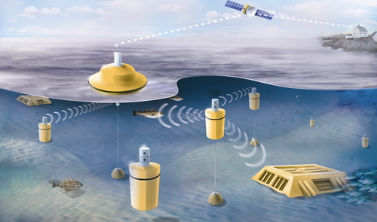
INTRODUCTION

Slide 6
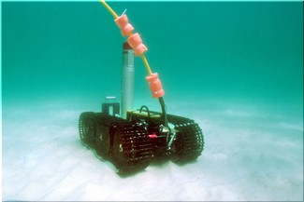
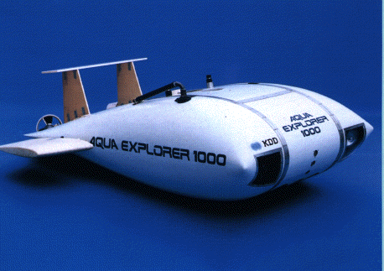
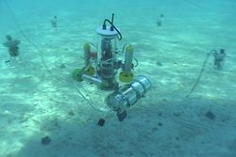
INTRODUCTION
Group of sensors and vehicles deployed
underwater and networked via acoustic
links, performing collaborative tasks
Equipment
  Autonomous Underwater Vehicles (AUVs)
  Underwater sensors (UW-ASN)

Slide 7
UW Architectures and UWSN
Two-dimensional Underwater Sensor
Networks : for ocean bottom monitoring
Three-dimensional Underwater Sensor
Networks : for ocean-column monitoring
Sensor Networks with Autonomous UW
vehicles : for underwater explorations

Slide 8

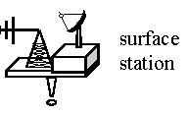

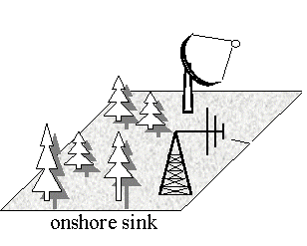
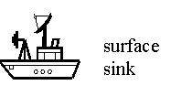

UW Architectures and UWSN
1. Static two-dimensional UW-ASNs for
ocean bottom monitoring
  Components:

Slide 9
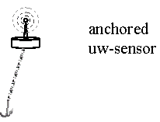
UW Architectures and UWSN Cont.
2. Three-dimensional Underwater Sensor
Networks
  Components:

Slide 10
UW Architectures and UWSN Cont.
3. Sensor Networks with Autonomous
Underwater vehicles
  Components:

Slide 11
Research Challenges
  Security & Robustness.
  Traffic Congestion Control.
  Efficient Multiple Access.
  To increase the Limited Battery Power
  To reduce the High delay
    Propagation delay Underwater=5 x Radio Frequency(RF)ground

Slide 12
Network Layer Protocols

Slide 13
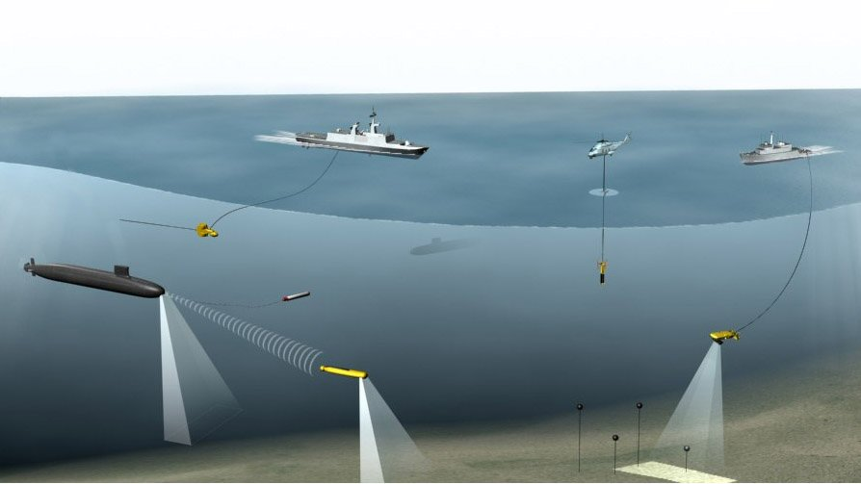
Applications
  Environment monitoring
  Undersea explorations
  Disaster prevention
  Assisted navigation
  Application to oil-field monitoring

Slide 14
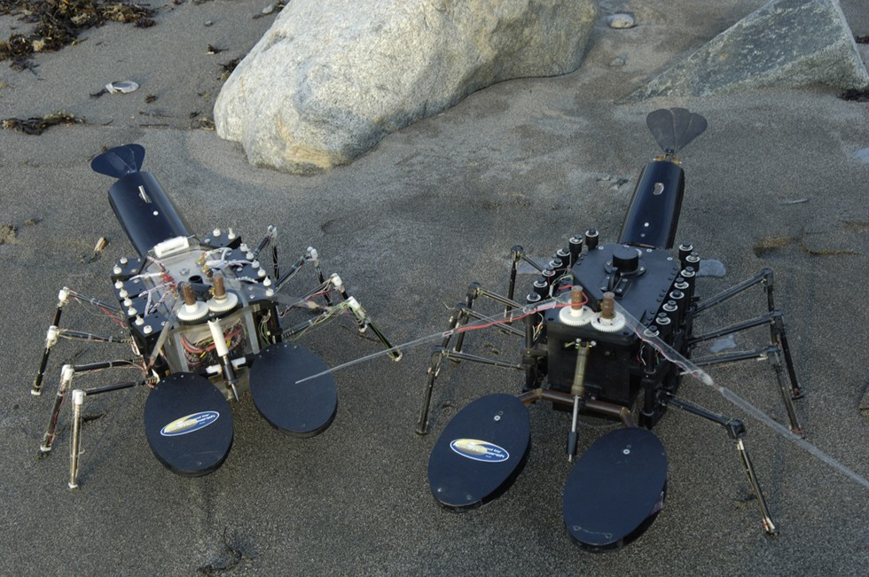
Underwater Remote Sensors

Slide 15
Advantages
Real time Underwater security.
Quick alert monitoring in oil
field and gas station.
Provide mass communication without
having hectic wired system.
It can project better for marine researches,
naval systems & submarine for accurate
communication between them

Slide 16
Disadvantages
    UWSNs are expensive
    Power require for UWSNs is higher
    Tendency of failure in the underwater
    sensors because of corrosion

Slide 17
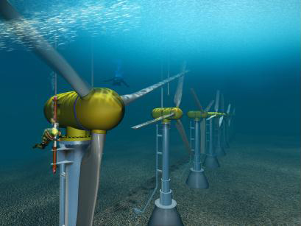
Future Expansions
In future information can be
transmitted digitally over a
wireless network..
A point-to-point optical
communication system, using
laser-emitting diodes (LEDs).

Slide 18
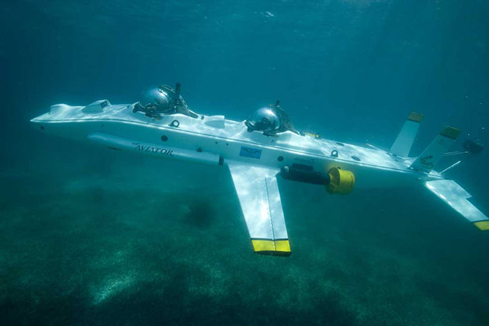
Future Expansions Cont.
Telesonar is an emerging technology for
wireless digital communications .
Mass communication for Future autonomous
Underwater Submarines.

Slide 19
Conclusions
Acoustic waves will be staying as
the major carrier of wireless communication
in UWSNs.
Losses can be avoided for long
distance by collaboration of terrestrial
networks and UWSNs.

Slide 20
References
[1] Under Water Sensor Networks at BWN Laboratory,
Georgia Institute of Technology, Available from
<http://www.ece.gatech.edu/research/labs/bwn/UWASN/>.
[2] Ocean Engineering at Florida Atlantic University,
Available From
<http://www.oe.fau.edu/research/ams.html/>.

Slide 21

Thank you!
Any Questions

